Slide 1
Research Methodology- Unit 2 Chapter 1- Research Problem, Research Objective, Research Questions and Research Hypothesis
Prime College- BIM 6th Semester

Slide 2
Research Methodology
Research Objective
Research Questions
Research Hypothesis
Assoc. Prof Dr Jugindar Singh

Slide 3
1.3 Research Purpose/Objective
A specific result that a person or system aims to achieve within a time frame and with available resources. Ask yourself what you hope to uncover through your research, and then say it in a way that the reader will understand.
Quantitative - Objective
To examine the relationship between customer satisfaction and customer loyalty
Qualitative: Purpose Statement
The purpose of this qualitative case study is to understand the practices of adult educators in reading and responding to emotional states exhibited by learners in Kuala Lumpur.
For quantitative study, use the words:
To examine
To evaluate
To determine
To assess
To investigate
For qualitative study, use the words:
To explore
To understand

Slide 4
1.3 Purpose Statement and Objective
Purpose Statement/Objective - Quantitative
The objective of this study is to determine if different types of teacher feedback affect a
fifth-grade student’s motivation and achievement.
Variables: The independent variables will be different types of feedback (i.e., graphical and traditional report cards); the dependent variables will be student motivation
and achievement as measured using numeric scales.
Participants: Teachers and fifth-grade students.
Unit of analysis: Students.
Location: An elementary school in Dade County, Florida.
Purpose Statement - Qualitative
The purpose of this study is to understand the life experiences of female math majors in
an effort to understand why they chose to major in math.
Central phenomenon: Reasons females choose to major in math.
Participants: Female math majors.
Unit of analysis: Individual female math majors.
Location: Pleasantville University.
Purpose statement tells the reader the overarching focus or goal of your study and should be included in both quantitative and qualitative research studies

Slide 5
1.4 Research Questions
Research questions (RQs) are refined statements of the specific components of the problem.
The research questions must be in line with the objectives and should indicate the variables under investigation.
They should be clearly and unambiguously framed as they will influence research methodology and the type of data analysis to be conducted.
Quantitative Research Questions
1.What is the impact of Trust on intention to adopt of e-wallet among Gen Z?
2. What is the impact of Perceived Ease of Use on intention to adopt of e-wallet among Gen Z?
3. What is the impact of Perceived Security on intention to adopt of e-wallet among Gen Z?
Qualitative Research Questions
RQ1: What are the major stressors associated with the online learning by students? Stress Attributes
RQ2: How has the current situation affected the students’ mental health? (
Questions start with “What” or ‘How’
A good research question is essential to guide your research paper, project or thesis. It pinpoints exactly what you want to find out and gives your work a clear focus and purpose

Slide 6
Research Questions: focusing on exactly what we are trying to understand
The research question is derived from the purpose statement/problem statement.
The research question is clear and focused.
The research question adheres to the same criteria as that of the problem statement:
a. Scope is manageable – not too broad
b. You have time, knowledge, and
resources
d. Data can be collected and analyzed.
e. Has theoretical or practical significance.
Quantitative Example
Is a student’s motivation level significantly affected by the use of graphical feedback to report the students’ grades?
Qualitative Example What is the perception of students towards online learning
Focus Unfocused: What is the effect on the environment from global warming?
Focused: What is the most significant effect of glacial melting on the lives of penguins in Antarctica?

Slide 7

The determinants of consumers intention to adopt e-Wallet. A quantitative study among Gen Z in Jakarta
GENERAL OBJECTIVE
Main objective TO EXAMINE THE FACTORS THAT INFLUENCE THE ADOPTION OF e-WALLET BY GEN Z IN JAKARTA
SPECIFIC OBJECTIVES
To examine whether there a relationship between Trust and intention to adopt of e-wallet among Gen Z in Jakarta.
To examine whether there a relationship between Perceived Ease of Use and intention to adopt of e-wallet among Gen Z in Jakarta
To examine whether there a relationship between Perceived Security and intention to adopt of e-wallet among Gen Z in Jakarta
Objective of the study is what you intend to accomplish when you design your study.

Slide 8
The Relationship between Service Quality and Customer Satisfaction
GENERAL OBJECTIVE
GENERALLY, THE OBJECTIVE OF THIS STUDY IS TO EXAMINE THE RELATIONSHIPS BETWEEN Service Quality and Customer Satisfaction
SPECIFIC OBJECTIVES
TO DETERMINE whether there is a RELATIONSHIP BETWEEN Responsiveness and Customer Satisfaction
TO examine whether there is a SIGNIFICANT RELATIONSHIP BETWEEN Assurance and Customer Satisfaction
is a clear and concise statement of the purpose and aim of the study which essentially summarizes what needs to be achieved by the study

Slide 9
Examples of research objectives , Source Awang Z. 2012
Example 1:
1. The objective of this study is to identify the factors that contribute to the declining demand for Proton among the Malaysian customers.
2. The objective of this study is to generate the items that constitute service quality in higher education from the students’ perspective.
3. The objective of this study is to measure the strength of association between socio-economic status of customers and their perception of quality concerning the service provided by higher educational institutions in the country.
4. The objective of this study is to assess the influence of service quality provided by the university and the corporate image of a university on students’ loyalty towards their university in doing postgraduate study.

Slide 10
Examples of research objectives , Source Awang Z. 2012
Example 2:
The objective of the study Specifically the study is designed to achieve the following objectives: 1. To assess the effects of certain demographic variables on service quality, corporate image, and students’ satisfaction.
To determine the influence of service quality provided at the university on students’ satisfaction with their learning experience
To determine the influence of corporate image of the university on students’ satisfaction with their learning experience
To determine the influence of service quality provided at the university on students’ loyalty towards their university

Slide 11
Examples of research objectives , Source: Sekaran and Bougie
To find out what motivates consumers to buy a product online.
To study the effect of leadership style on employees ’ job satisfaction.
To investigate the relationship between capital structure and profitability of the firm.
To establish success factors regarding the adoption and use of information systems.
To determine the optimal price for a product.
To investigate the influence of the in‐store shopping environment on impulse buying.
To establish the determinants of employee involvement.
To examine the causes of employee absence.

Slide 12
Research objectives - Exercise
Write the objectives of the study titled:
“The influence of service quality dimensions in higher education from the students‟ perspective and how the quality of service influences the loyalty of students”.
Use words like:
1. To identify factors that affect……
2. To examine the influence of……
3. To determine the probable cause of……
4. To refine the current understanding of……
5. To measure the strength of the correlation between…..
6. To study the effectiveness of e-learning in……
7. To evaluate the cause and effect of……

Slide 13
Purpose Statement Creswell, 2018)
Creswell (2003) advised the following script for purpose statements in qualitative research:
The purpose (or study aim) of this ___________ (strategy of inquiry, such as ethnography, case study, or other type) study is (was? will be?) to ___________ (understand? explore? develop? generate? discover?) the ___________ (central phenomenon being studied) for ___________ (the participants, such as the individual, groups, organization) at ___________ (research site). At this stage in the research, the ___________ (central phenomenon being studied) will be generally defined as ___________ (provide a general definition).

Slide 14
Purpose Statement
Here is a script for a good qualitative purpose statement:
“The purpose of this qualitative study (replace later with type of qualitative tradition) will be to ______(understand, describe, develop, discover) the ________(central focus) for _______(participants: person, process, groups) at ______________(site)."
Good purpose statements:
Flow from the problem statement and address the proposed problem
Are concise and clear
Answer the question ‘Why are you doing this research?’
Match the methodology (similar to research questions)
Example:
Perception of Employers towards hiring of ex-offenders
Purpose Statement
The purpose of this qualitative study will be to understand the perception of employers towards hiring of ex-offenders in the education sector in Kuala Lumpur

Slide 15
Qualitative Questions
Script for a qualitative central question:
_________ (How or what?) is the _________ (“story for” for narrative
research; “meaning of” the phenomenon for phenomenology; “theory
that explains the process of” for grounded theory; “culture-sharing
pattern” for ethnography; “issue” in the “case” for case study) of
_________ (central phenomenon) for _________ (participants) at
_________ (research site).
Example:
Explore How do women in a psychology doctoral program describe their decision to return to school?
Explore How do women in a psychology doctoral program describe their reentry experiences?
Explore How does returning to graduate school change these women’s lives? (p. 328)

Slide 16
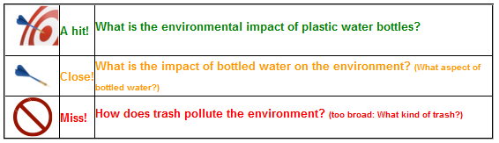
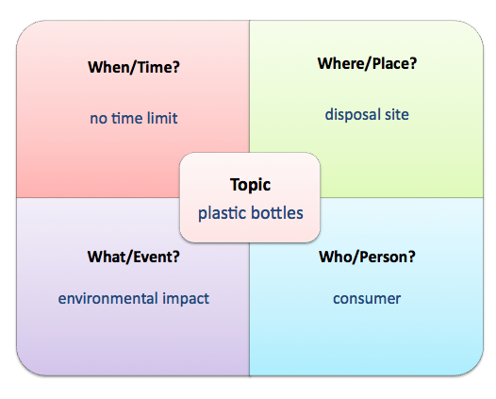
Research Question: What is the environmental impact of the disposal of plastic water bottles?

Slide 17
Types of Questions
Research question type | Formulation
Descriptive research | What are the characteristics of X?
Comparative research | What are the differences and similarities between X and Y?
Correlational research | What is the Correlation between variable X and variable Y?
Exploratory research | What are the main factors in X? What is the role of Y in Z?
Explanatory research | Does X influence Y? What is the impact of Y on Z? What are the causes of X

Slide 18
Examples of Research Questions: Source – Awang, Z. 2012
This study attempts to address the following research questions:
1. How significant is the effect of respondent’s socio-economic status on service quality, corporate image, and students’ satisfaction?
2. How significant is the effect service quality provided by the university in influencing students’ satisfaction with the university?
3. How significant is the effect of corporate image of the university in influencing students’ satisfaction towards the university?
4. How significant is the effect of service quality at the university in influencing students’ loyalty towards that university in the future?
5. How significant is the effect of corporate image of the university in influencing students’ loyalty towards that university in the future?
6. How significant is the students’ satisfactions with the university manage to influence their loyalty towards that particular university? Or in other words, the study is interested to answer questions like “Is there a significant relationship exists between students’ satisfaction and their loyalty?”

Slide 19
Research Questions Examples
1. Is there a relationship between Responsiveness and customer satisfaction?
2. Is there a correlation between Assurance and customer satisfaction?
3. Is there a difference based on gender towards customer satisfaction?
4. Will Women have higher customer satisfaction than their male counterparts?
Quantitative: Use Verbs like: Relate, Influence, Cause, effect
Qualitative: Use verbs like: Explore, Discover, Describe

Slide 20
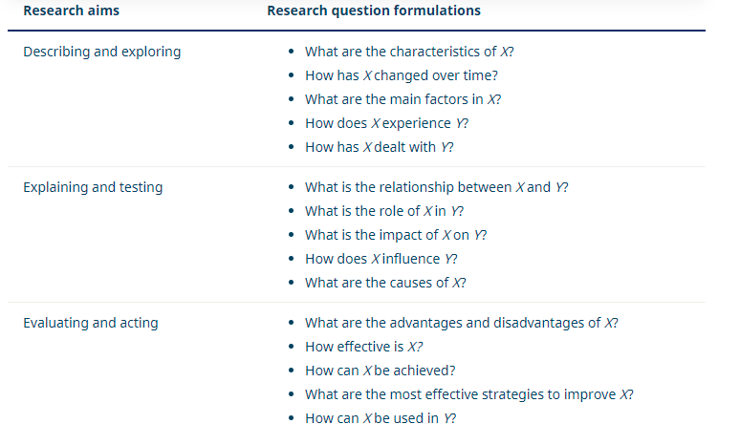
Research Aims and Question Formulation

Slide 21


Slide 22
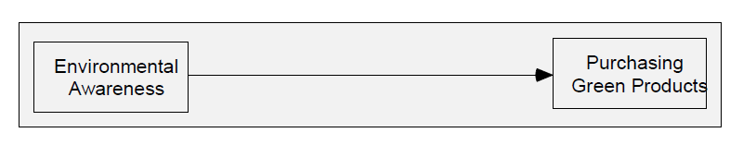
1.5 Research Hypotheses
A hypothesis is an educated statement, or a preconceived idea made by a researcher regarding the underlying problem in his research.
It provides the direction of a study, such as the variables of interest, the method of sampling, the method of data collection, and the types of statistical analysis to be performed.
A hypothesis is a declarative statement made by a researcher whereby he would prove it with empirical evidence.
Title: Relationship between Consumers‟ environmental awareness and their purchasing behavior towards environmental-friendly (green) products.
Hypothesis
H1: Consumers‟ environmental awareness has a significant influence on their purchasing behavior towards green products.

Slide 23
HYPOTHESES
The Relationship between attendance and student performance
Attendance
Performance
Null hypothesis
H0: The number of lectures attended by first-year students has no effect on their final exam scores.
Alternate hypothesis
H1: The number of lectures attended by first-year students has a positive effect on their final exam scores.

Slide 24
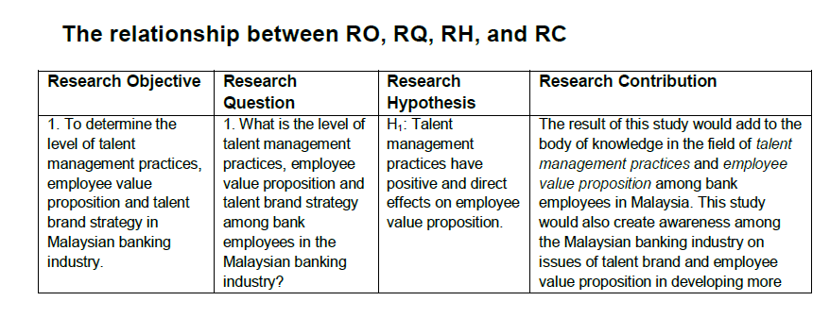
Objective, Question and Hypothesis – there must be alignment

Slide 25

Objective, Question and Hypothesis – there must be alignment
Research Objective | Research Question | Research Hypothesis
To examine the relationship between Leadership Style and Employee performance. | Does leadership style enhance employees performance? | There is a positive and significant relationship between leadership style and employee performance.
To examine the relationship between Ease of Use and intention to use E-Wallet | Does Ease of Use influence the intention to use E-wallet? | There is a positive and significant relationship between Ease of use and intention to use e-Wallet.
To examine the relationship between Career growth and employee retention | Does Career growth influence the employees retention? | There is a positive and significant relationship career growth and employee retention
Purpose
Statement

Slide 26
Putting It Together: Problem Statements, Purpose Statements, and Research Questions
Do the problem statement, purpose statement, and research questions flow together?
Research Problem: Phd students take too long to complete their thesis.
Research Purpose: The purpose of this research is to investigate reasons Phd students take too long to complete their thesis
Research Question: Does the Supervisor competency affect the completion of thesis by Phd students
The research purpose directly addresses the research problem, and the research question seems to be a direct extension of the purpose statement.

Slide 27


Learning Outcome 4
Explain How to write research significance, scope, Limitations, Definition of terms
Milestone 1: Student should be able to identify research topic

Slide 28
1.6 Significance of Study
Present the rationale of your proposed study and clearly indicate why it is worth doing. Briefly tell the reader the significance of the study (justify doing the study). You can argue the significance of your study from managerial, theoretical, and academic perspectives.
Theoretical
How will the findings assist or be of benefit to the body of knowledge ?
Eg: “This study will contribute to the body of knowledge on skills……… development
Practical
How would the solution to the problem influence practice? Who may be interested in using these findings
Eg:The findings will be useful for HR managers address the current shortage of skills in the current environment…
Academic
How will academicians benefit from this study?
Eg: Academicians can replicate or extend similar study to other counties/cultures…..

Slide 29

1.7 Scope of the Study
Set the boundaries of your proposed research in order to provide a clear focus. Where appropriate, state not only what you will study but what is excluded from the study.
Setting the Boundary
The scope of the study will be narrowed.
Coverage of research
Research population/respondents
Geographical location
Methodology

Slide 30
1.7 Scope of the Study
Set the boundaries of your proposed research in order to provide a clear focus. Where appropriate, state not only what you will study but what is excluded from the study.
Setting the Boundary
The scope of the study will be narrowed.
Coverage of research
Research population/respondents
Geographical location
Methodology

Slide 31

1.8 Limitations of the Study
The limitations of the study refer to elements that are beyond the control of the researcher.
Some common limitations faced by researchers are, for example, limitations due to the small sample size, measuring instruments, or generalizability of the results.
Do not be intimidated by the limitations of the study because it is not possible to expect every research conducted to be perfect. They merely indicate to the reader that you are aware of the limitations and that the findings should be interpreted in light of these limitations.
Limitations identify potential weakness or limitations in the design or methods
Example:
Sampling method,
Sample size
Self-reported data,
Limitation on generalizability
Social desirability bias
No Moderator Eg Age
Only limited predictors used Common method Variance

Slide 32




Summary
Congratulations You have learnt about Chapter 1.
Background information
The research problem
Research questions/objectives/hypothesis
Research significance, scope, limitations and definition of term
Start writing your Chapter 1. You need to search for articles and literature to support your study

Slide 33
End of Chapter 2
Find out more at the PowerPoint Getting Started Center
(Click the arrow when in Slide Show mode)
Notes:
In Slide Show mode, click the arrow to enter the PowerPoint Getting Started Center.

